Slide 1
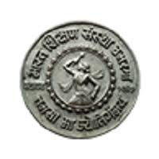
“DIGITAL ELECTRONIC” Paper Code : CS-02
SHRI CHHATRAPATI SHIVAJI COLLEGE , OMERGA
Prepared by
Mrs. Nitnaware Reshma Ramdas
Asst. Prof. in Computer Science

Slide 2
Chapter - I

Slide 3
NUMBER SYSTEM
A number system is simply a way of representing numeric values. It uses symbols called numerals to represent numeric quantities.
It relates quantities and symbols. In number system there is an ordered set of symbols known as digits with rules for defined for performing arithmetic operations like addition, subtraction, multiplication, division. The base of a system represents number digit in that particular number system.

Slide 4
Types of Number Systems
Decimal Number System
Binary Number System
Octal Number System
Hexadecimal Number System

Slide 5
BASE OR RADIX
In digital electronics, the number system is used for representing the information.
The base or radix of the number system is the total number of the digit used in the number system. Suppose if the number system representing the digit from 0 – 9 then the base of the system is the 10.
Formula : - 0 to r-1
where r is Radix or Base

Slide 6
Diagram of Number Systems

Slide 7
1. Binary Number Systems
The modern computers do not process decimal number; they work with another number system known as a binary number system which uses only two digits 0 and1.
The base of binary number system is 2 because it has only two digit 0 and 1.The digital electronic equipment's are works on the binary number system and hence the decimal number system is converted into binary system.
Example
Binary Number: i) 10001₂
ii) 10101.1111₂
iii ) 100.100₂

Slide 8
3. Octal Numbers
The octal system has the base or Radix of eight as it uses eight digits 0, 1, 2, 3, 4, 5, 6, 7.
In this Number system, eight symbols i.e.,0,1,2,…..7 are used to represent the number.
Since its base is, 8=2³ every 3-bit group of binary can be represented by an octal digit.
Example
Octal Number − i) 10001₈
ii) 12570₈
iii ) 100.100₈

Slide 9
3. Decimal Number Systems
The Decimal number system that we use in our day-to-day life is the decimal number system . The Decimal system has the base or Radix of Ten as it uses Ten digits 0, 1, 2, 3, 4, 5, 6, 7, 8, 9.
The Decimal number system is having digit 0, 1, 2, 3, 4, 5, 6, 7, 8, 9; this number system is known as a decimal number system because total ten digits are involved.
Example
Decimal Number − i) 78956₁₀
ii) 123.456₁₀
iii ) 100.100₁₀

Slide 10
4. Hexadecimal Numbers
The hexadecimal number system has a base or radix of 16, and this Number system is combination of numbers and digits , hence it consists of the following sixteen number of digits.
0, 1, 2, 3, 4, 5, 6, 7, 8, 9, A, B, C, D, E, F.
The size of the hexadecimal is much shorter than the binary number which makes them easy to write and remember. Let 0000 to 000F representing hexadecimal numbers from zero to fifteen, then 0010, 0011, 0012, …etc. Will represent sixteen, seventeen, eighteen… etc. till 001F which represent thirty open and so on.
Example
Decimal Number − i) 95AB₁₆
ii) ABC.DEF₁₆
iii) 100.100₁₆

Slide 11
Decimal | Binary | Octal | Hexadecimal
0 | 0000 | 0 | 0
1 | 0001 | 1 | 1
2 | 0010 | 2 | 2
3 | 0011 | 3 | 3
4 | 0100 | 4 | 4
5 | 0101 | 5 | 5
6 | 0110 | 6 | 6
7 | 0111 | 7 | 7
8 | 1000 | 10 | 8
9 | 1001 | 11 | 9
10 | 1010 | 12 | A
11 | 1011 | 13 | B
12 | 1100 | 14 | C
13 | 1101 | 15 | D
14 | 1110 | 16 | E
15 | 1111 | 17 | F
2² 2¹ 2⁰
2³ 2² 2¹ 2⁰
Table for Number System

Slide 12
NUMBER SYSTEM CONVERSION

Slide 13
BINARY NUMBER SYSTEM CONVERSION
There are three conversions possible for binary number, i.e., binary to decimal, binary to octal, and binary to hexadecimal.
I) Binary to Octal Conversion :-
The base numbers of binary and octal are 2 and 8, respectively. In a binary number, the pair of three bits is equal to one octal digit. There are only two steps to convert a binary number into an octal number which are as follows:
Example 1: (111110101011.0011)₂
Firstly, we make pairs of three bits on both sides of the binary point.
= 111 110 101 011 . 001 1
On the right side of the binary point, the last pair has only one bit. To make it a complete pair of three bits,
we added two zero's on the extreme side.
= 111 110 101 011 . 001 100
Then, Put the Octal Number
= (111110101011.0011)₂=(7653.14)₈

Slide 14
2. Binary to Decimal Conversion
The process of converting binary to decimal is quite simple. The process starts from multiplying the bits of binary number with its corresponding positional weights. And lastly, we add all those products.
Example 1: (10110.001)₂
We multiplied each bit of (10110.001)₂ with its respective positional weight, and
last we add the products of all the bits with its weight.
(10110.001)₂=(1×2⁴)+(0×2³)+(1×2²)+(1×2¹)+(0×2⁰)+(0×2⁻¹)+(0×2⁻²)+(1×2⁻³) (10110.001)₂=(1×16)+(0×8)+(1×4)+(1×2)+(0×1)+(0×1⁄2)+(0×1⁄4)+(1×1⁄8) (10110.001)₂=16+0+4+2+0+0+0+0.125 (10110.001)₂=(22.125 )₁₀

Slide 15
3. Binary to Hexadecimal Conversion
The base numbers of binary and hexadecimal are 2 and 16, respectively. In a binary number, the pair of four bits is equal to one hexadecimal digit. There are also only two steps to convert a binary number into a hexadecimal number which are as follows:
In the first step, we have to make the pairs of four bits on both sides of the binary point. If there will be one, two, or three bits left in a pair of four bits pair, we add the required number of zero's on extreme sides.
Example 1: (10110101011.0011)₂
Firstly, we make pairs of four bits on both sides of the binary point.
111 1010 1011.0011
On the left side of the binary point, the first pair has three bits. To make it a complete pair of four bits, add one zero on the extreme side.
0111 1010 1011.0011
Then, we write the hexadecimal digits, which correspond to each pair.
(011110101011.0011)₂=(7AB.3)₁₆

Slide 16
OCTAL NUMBER SYSTEM CONVERSION
There are three conversions possible for Octal number, i.e., Octal to binary, Octal to decimal, and Octal to hexadecimal.
Octal to Binary Conversion : -
The process of converting octal to binary is the reverse process of binary to octal. We write the three bits binary code of each octal number digit.
Example 1: (152.25)₈ = (?)₂
= 1 5 2 . 2 7
Put the Three bit Binary code
= 1 5 2 . 2 7
= 001 101 010 . 010 111
(152.25)₈=(001101010.010111)₂

Slide 17
II . Octal to Decimal Conversion
The process of converting octal to decimal is the same as binary to decimal. The process starts from multiplying the digits of octal numbers with its corresponding positional weights. And lastly, we add all those products.
Example 1: (152.25)₈ ₌ (?)₁₀
(152.25)₈ = (1×8²)+(5×8¹)+(2×8⁰)+(2×8⁻¹)+(5×8⁻²) = 64+40+2+(2×1⁄8)+(5×1⁄64) = 64+40+2+0.25+0.078125 (152.25)₈ = (106.328125) ₁₀

Slide 18
III. Octal to Hexadecimal
When converting from octal to hexadecimal, it is often easier to first convert the octal number into binary and then from binary into hexadecimal.
we have to make the pairs of four bits on both sides of the binary point. If there will be one, two, or three bits left in a pair of four bits pair, we add the required number of zero’s on extreme sides and write the hexadecimal digits corresponding to each pair.
Example 1: (1752.250)₈ ₌ (?)₁₆
= 1 7 5 2 . 2 5 0
make pair of 4 bits on both sides of the binary point
= 1 7 5 2 . 2 5 0 Octal Value
= ( 001 111 101 010 . 010 101 000 ) Binary Value
= 0011 1110 1010 . 0101 0100 0000
Put Hexa. Value
(1752.250)₈ ₌ (3EA.540) ₁₆

Slide 19
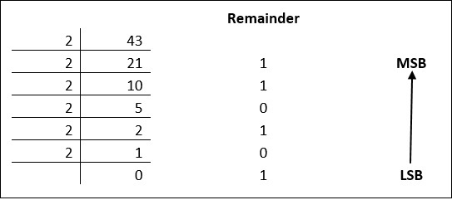
DECIMAL NUMBER SYSTEM CONVERSION :- Decimal to Other Base System use a Double Dabble method use.
Step 1 − Divide the decimal number to be converted by the value of the new base.
Step 2 − Get the remainder from Step 1 as the rightmost digit (least significant digit) of new base number.
Step 3 − Divide the quotient of the previous divide by the new base.
Step 4 − Record the remainder from Step 3 as the next digit (to the left) of the new base number.
I . Decimal to Binary :
Example :- 1. (43)₁₀=(?)₂ 2. (13)₁₀=(?)₂
MSB
LSB
= (101011)₂

Slide 20
II . Decimal to Octal : -
Decimal numbers can be converted to octal by repeated division of the number by 8 while recording the remainder.
473₁₀ = 731₈
86₁₀ = 621₈

Slide 21
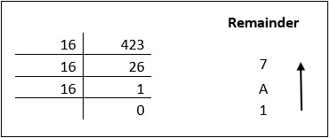
III . Decimal to Hexadecimal :-
Decimal numbers can be converted to octal by repeated division of the number by 16 while recording the remainder.
423₁₀ = 1A7₁₆
2861₁₀ = D2B₁₆

Slide 22
Hexadecimal Number System Conversions :
As we know, there are 16 digits in hexadecimal numbers, represented from 0 to 9 same like decimals, but after that, it starts with an alphabetical representation of preceding numbers such as A, B, C, D and E. Let us see the conversion of ‘hex’ into other number systems.
I. Hexadecimal to Binary Conversion :-
The process of converting hexadecimal to binary is the reverse process of binary to hexadecimal. We write the four bits binary code of each hexadecimal number digit.
Example 1: (152A.25)₁₆ = (?)₂
= 1 5 2 A . 2 5
(152A.25)₁₆ = (0001 0101 0010 1010.0010 0101)₂

Slide 23
II. Hexadecimal to Decimal :-
The process of converting hexadecimal to decimal is the same as binary to decimal. The process starts from multiplying the digits of hexadecimal numbers with its corresponding positional weights. And lastly, we add all those products.
Let's take an example to understand how the conversion is done from hexadecimal to decimal.
Example 1: (152A.25)₁₆=
We multiply each digit of 152A.25 with its respective positional weight, and last we add the products of all the bits with its weight.
(152A.25)₁₆ = (1×16³)+(5×16²)+(2×16¹)+(A×16⁰)+(2×16⁻¹)+(5×16⁻²) (152A.25)₁₆ = (1×4096)+(5×256)+(2×16)+(10×1)+(2×16⁻¹)+(5×16⁻²) (152A.25)₁₆ = 4096 + 1280 + 32 + 10 + (2×1⁄16) + (5×1⁄256) (152A.25)₁₆ = 5418 + 0.125 + 0.125 (152A.25)₁₆ = (5418.14453125)₁₀

Slide 24
III. Hexadecimal to Octal Conversion
For converting hexadecimal to octal, there are two steps required to perform, which are as follows:
In the first step, we will find the binary equivalent of the hexadecimal number.
Next, we have to make the pairs of three bits on both sides of the binary point. If there will be one or two bits left in a pair of three bits pair, we add the required number of zero’s on extreme sides and write the octal digits corresponding to each pair.
Example 1: (152A.25)₁₆
Step 1: We write the four-bit binary digit for 1, 5, 2, A, and 5.
(152A.25)₁₆=(0001 0101 0010 1010.0010 0101)₂
So, the binary number of hexadecimal number 152A.25 is (0011010101010.010101)₂
Step 2: Then, we make pairs of three bits on both sides of the binary point.
001 010 100 101 010.001 001 010
4. Then, we write the octal digit, which corresponds to each pair.
(001010100101010.001001010)₂=(12452.112)₈

Slide 25
Assignment - 1
What is Number System? Explain Types of No. System with base or radix
(111010.110)₂=(?)₈
(100.100)₂=(?)₁₀
(1010.1010)₂=(?)₁₆
(123.45)8=(?)2
(765.10)8=(?)10
(456.723)8=(?)16
(100.100)10=(?)₂ & (?)₈ & (?)₁₆
(12345.6789)10=(?)2 & (?)8 & (?)16
(ABC.123)16=(?)2 & (?)8 & (?)

Slide 26
Arithmetic Operations of Binary Number
Binary arithmetic is an essential part of various digital systems. You can add, subtract, multiply, and divide binary numbers using various methods. These operations are much easier than decimal number arithmetic operations because the binary system has only two digits: 0 and 1.
Binary arithmetic operation starts from the least significant bit i.e. from the rightmost side.

Slide 27
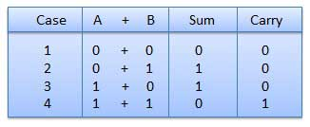
1. Binary Addition : -
It is a key for binary subtraction, multiplication, division. There are four rules of binary addition.
There are four Rules in binary addition, they are written below
0 + 0 = 0
0 + 1 = 1
1 + 0 = 1
1 + 1 = 0 (carry 1 to the next significant bit)
In fourth case, a binary addition is creating a sum of (1 + 1 = 10) i.e. 0 is written in the given column and a carry of 1 over to the next column.

Slide 28
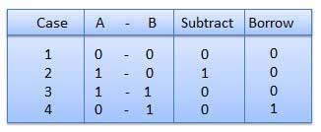
2. Binary Subtraction :-
Subtraction and Borrow, these two words will be used very frequently for the binary subtraction. There are four rules of binary subtraction.

Slide 29
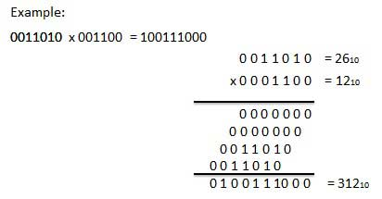
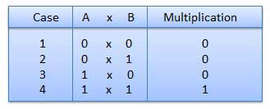
3. Binary Multiplication : -
Binary multiplication is similar to decimal multiplication. It is simpler than decimal multiplication because only 0s and 1s are involved. There are four rules of binary multiplication.
Rules :-

Slide 30
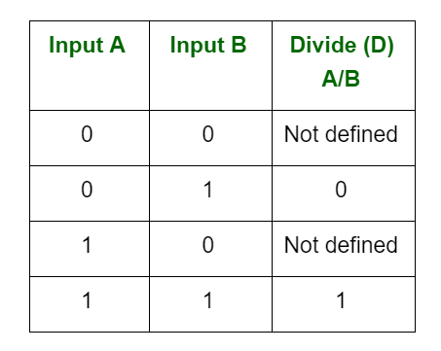
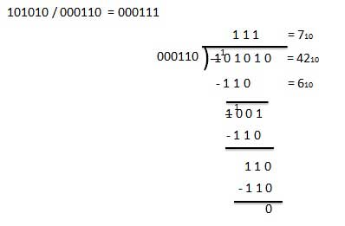
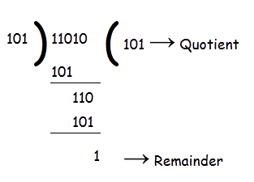
4. Binary Division :-
Binary division is similar to decimal division. It is called as the long division procedure.
There are four parts in any division: Dividend, Divisor, quotient, and remainder.
Example

Slide 32
1. Hexadecimal Addition :-
The Addition of hexadecimal numbers follow the same rules as the Addition of numbers in any other number system.
Evaluate: (B A 3)₁₆ + (5 D E)₁₆
3 + E = 11 A + D = 17 17 + 1 (carry) = 18 B + 5 = 10 10 + 1 (carry) = 11 | 1 1 carry B A 3 5 D E 1 1 8 1

Slide 33
2. Hexadecimal Subtraction:
Subtraction of hexadecimal numbers can be accomplished by using complement method. Although it is not a very simple method computers use it very efficiently.
These above explanation will help you to understand the concept about hexadecimal addition and subtraction.

Slide 34
Multiplication :- In the multiplication of hexadecimal numbers, if the product is less than radix of hexadecimal (i.e, 16), then we take it as the result, else divide it by radix of hexadecimal (i.e., 16) and take the remainder as the LSB (least significant bit). The quotient is taken as carry in the next significant digit. Using these rules, you can make a table for hexadecimal multiplications.

